Slide 1

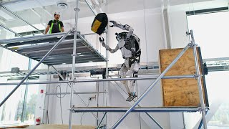

Module 1.2 (B)
Autonomous Robots: Robot Videos
Living and Working with Artificial Intelligence
Developed for the AI4GA (Artificial Intelligence for Georgia) project funded by National Science Foundation awards DRL-2049029 and DRL-2048502.
This work is licensed under the Creative Commons Attribution-NonCommercial-ShareAlike 4.0 International License. https://creativecommons.org/licenses/by-nc-sa/4.0/

Slide 2
Learning Objectives
Students should be able to:
Explain what autonomy means.
Given a robot, explain what it does and what kinds of decisions it makes.
Decide whether a device is a robot or not. Roombas are robots. Your grandmother’s antique Electrolux vacuum is not a robot. Why not?

Slide 3


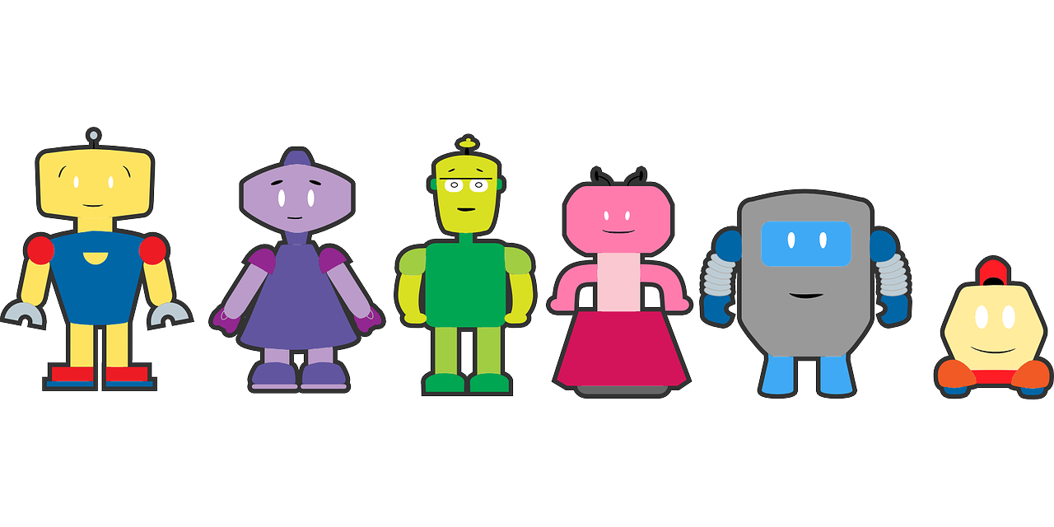
Robot Videos
All of the machines in the following videos ARE robots.
These machines follow all of the rules we learned in the previous activity.

Slide 4
New Question:
Do all robots have AI?
An autonomous robot can make decisions about what it will do.
Having “Artificial Intelligence” or AI means that the robot can “perceive” or make meaning of what it senses.

Slide 5
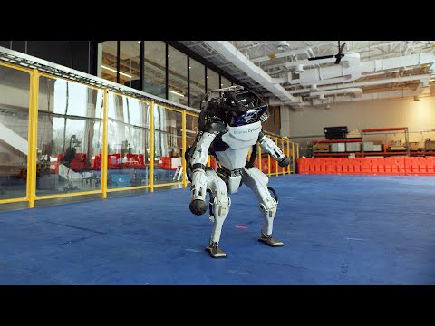
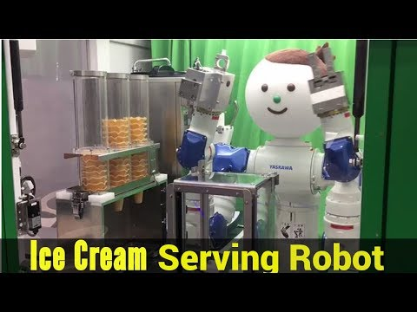
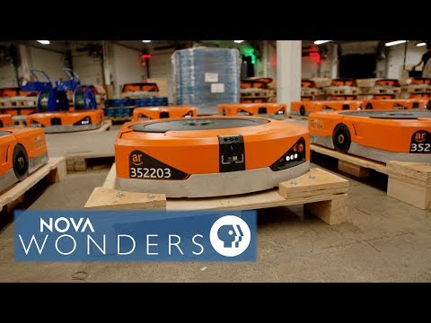
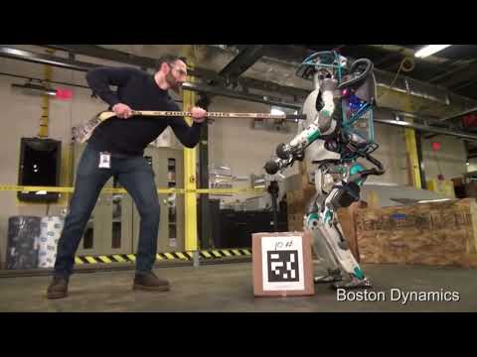

Whole Group Examples
Boston Dynamics
Ice Cream Shop
Kiva Wearhouse
Notes:
Choose an example you would like to use as a class to Think. Pair. Share (in whole group).
Think Pair Share:
1) What does the robot do/ what is its purpose?
2)What kinds of decisions did the robot make? (How was it autonomous?))

Slide 6

Directions:
Write a short summary of what the robot does.
What kinds of decisions did the robot make?
Be prepared to share your ideas with the class.
Notes:
Dave: add answers to these questions.

Slide 7
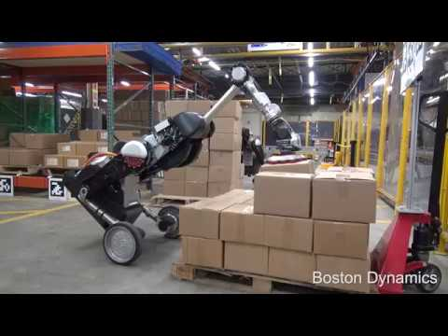
Robot Video #1 - Handle Robot
Notes:
What the robot does: moves boxes in a warehouse; stacks boxes on pallets.
What decisions it makes: which box to pick up next; how to pick up the box; where to place the box; how to navigate without hitting anything to get to the spot where it can place the box.

Slide 8
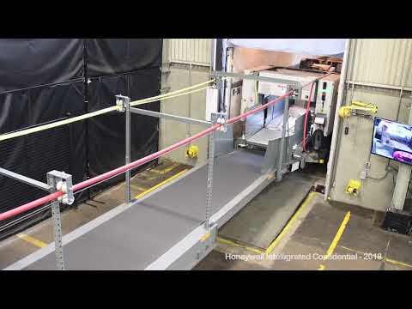
Robot Video #2 - Unloading a Truck
Notes:
What the robot does: unloads a truck by transferring boxes from the truck to a conveyor belt.
What decisions the robot makes: how to move its gripper to reach the boxes, how to grab them, and how to move its arm to get them onto the conveyor.

Slide 9
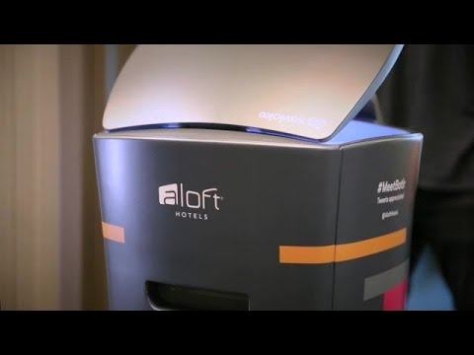
Robot Video #3 - Butler
Notes:
What the robot does: delivers items to hotel guests in their rooms.
What decisions the robot makes: how to navigate through the hotel, including using the elevator.

Slide 10
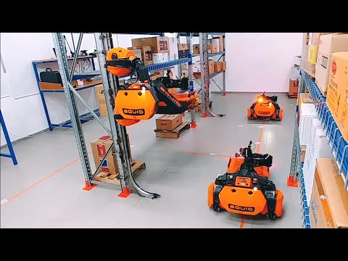
Robot Video #4 - Warehouse Robots
Notes:
First robot: What it does: Separates trash from recyclables on a moving conveyor belt.
Decisions it makes: recognizing which items are trash; calculating how to move the arms to remove the items.
Second robot: What it does: Moves boxes between warehouse shelves and pallets.
Decisions it makes: how to navigate around the shelves and warehouse; how to recognize and grasp a box.
Third robot: What it does: carries containers through a warehouse.
Decisions it makes: how to navigate safely, avoiding obstacles including people.
Fourth robot: this is the Handle robot covered on an earlier slide.
Fifth robot: what it does: unloads boxes of varied merchandise sealed in plastic bags.
Decisions it makes: how to select a bag and grasp it; determines whether an item is damaged or has an unreadable barcode

Slide 11
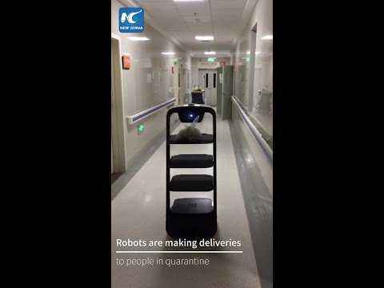
Robot Video #5 - In Hospitals (during COVID)
Notes:
What the robot does: delivers food or packages in a hospital or COVID quarantine facility.
What decisions does it make: how to navigate through the facility and find the correct room.

Slide 12
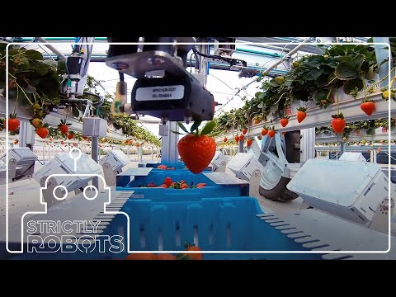
Robot Video #6 - Fruit Picking
Notes:
What the robot does: picks ripe strawberries and drops them in a container.
What decisions does it make: locating a strawberry; deciding whether it’s ripe enough to pick; guiding the arm to pick it and move it to the container.

Slide 13
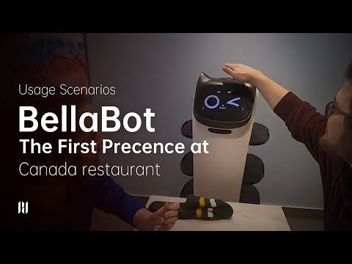
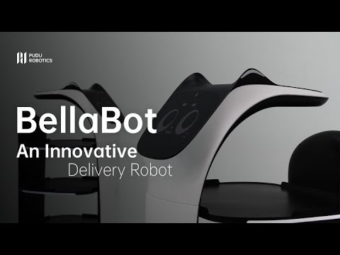
Robot Video #7 - In Restaurants
Notes:
What the robot does: delivers food to tables at a restaurant.
What decisions does it make: how to navigate while avoiding obstacles including people and other robots; how to recognize the table it’s supposed to deliver to.

Slide 14
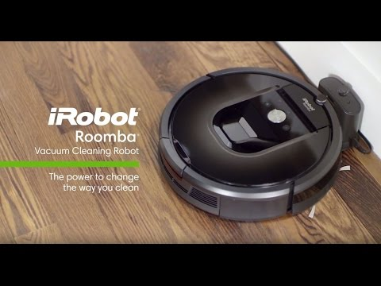
Robot Video #8 - Vacuum
Notes:
What the robot does: vacuums the floor.
What decisions does it make: what path to take to cover the floor efficiently without missing any spots, but avoiding obstacles; detecting and avoiding stairs; what power level to use based on the surface it’s moving on.

Slide 15
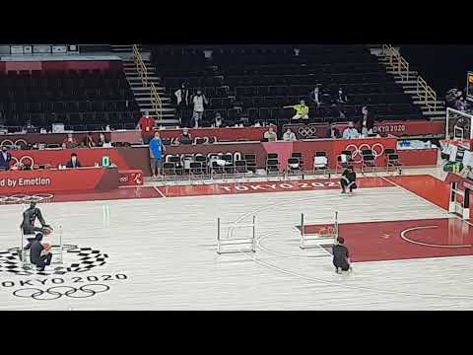
Robot Video #9 - Toyota Basketball Robot
Notes:
What does the robot do: shoots basketballs.
What decisions does it make: recognizing the ball and the basket; how to grasp the ball; how to shoot the ball to get it in the basket.

Slide 16
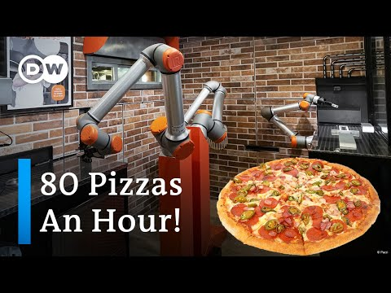
Robot Video #10 - Pizza-Making Robot
Notes:
What does the robot do: make pizzas.
What decisions does the robot make: how to check the dough and correct any problems if it’s not rolled out properly; how to move the arms to apply sauce and toppings, and to cut up the pizza after it’s baked.

Slide 17

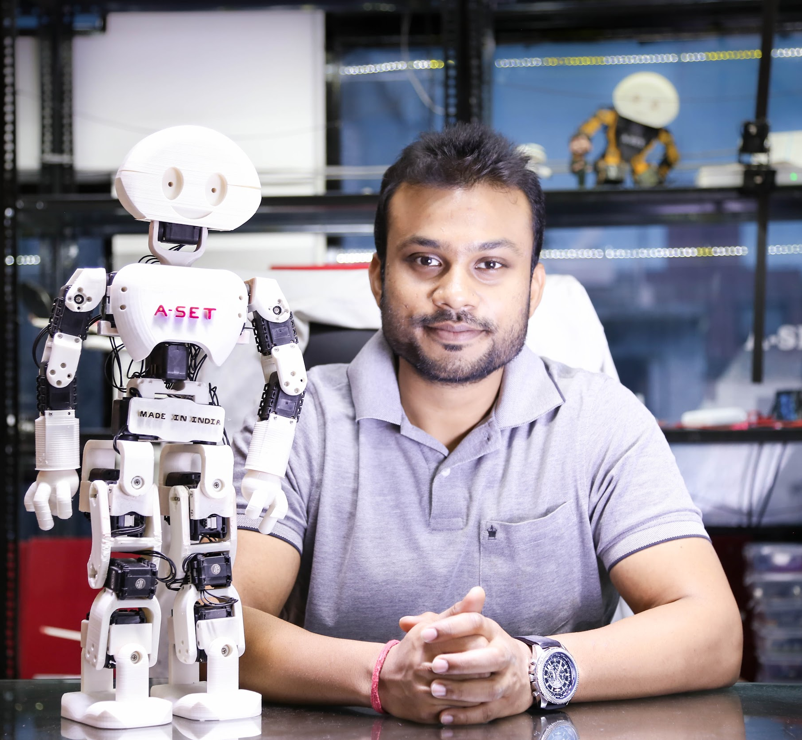
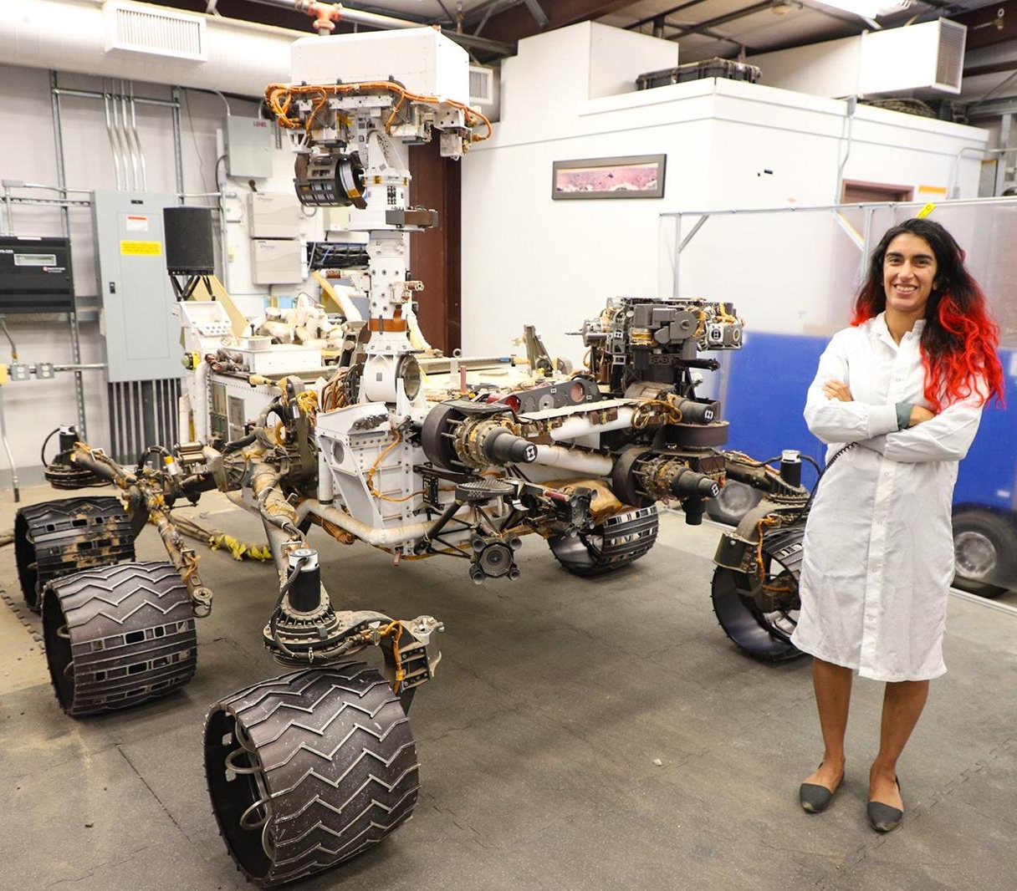
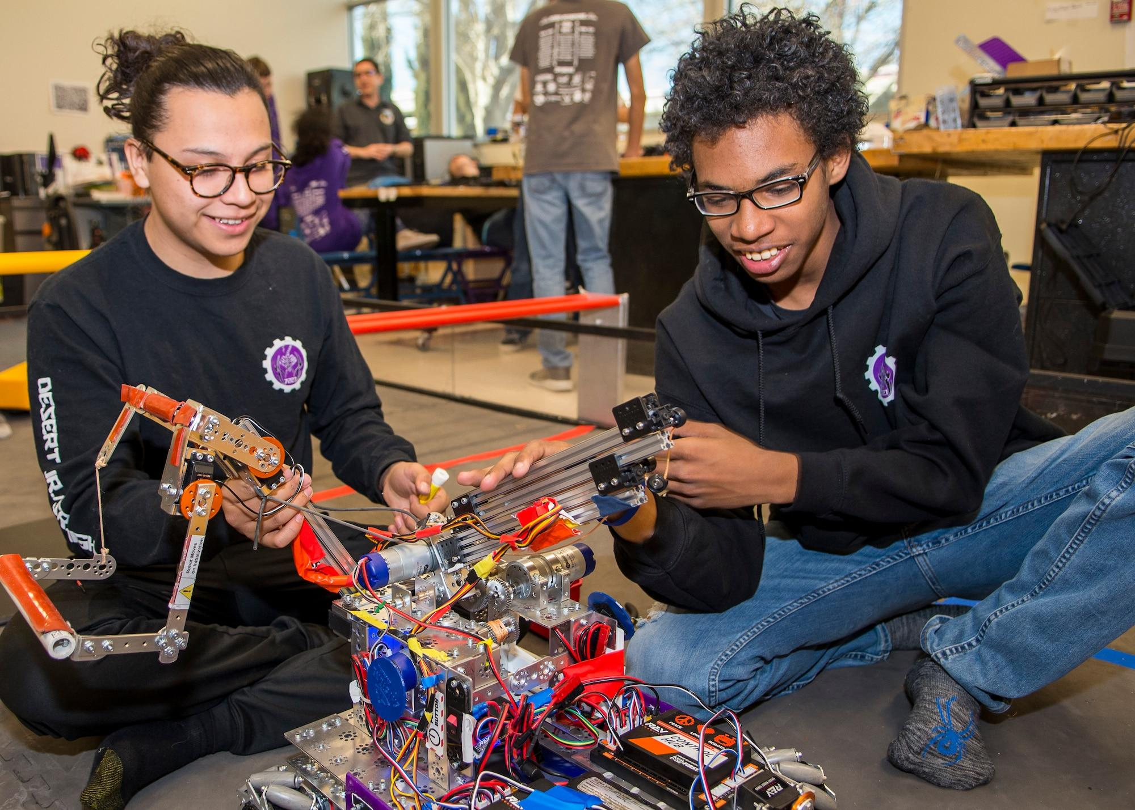
Careers in Robotics
Robotics is an interdisciplinary field that draws ideas from electrical engineering, mechanical engineering, and computer science (including artificial intelligence).
Roboticist: They are people who work with robots. They are specialized in the following areas:
Mechanical Engineer: Concerned with the physical and mechanical movement of robots and how they can operate efficiently e.g. how the legs moves and ensure they can balance
Electrical Engineer: Concerned with the sensors and other electronic circuitry that make up the robot e.g. the camera and microphones
Computer Scientist: They write the code that makes the robots function e.g. instructions that help a robot complete its tasks

Slide 18
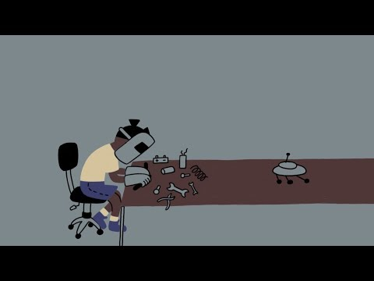
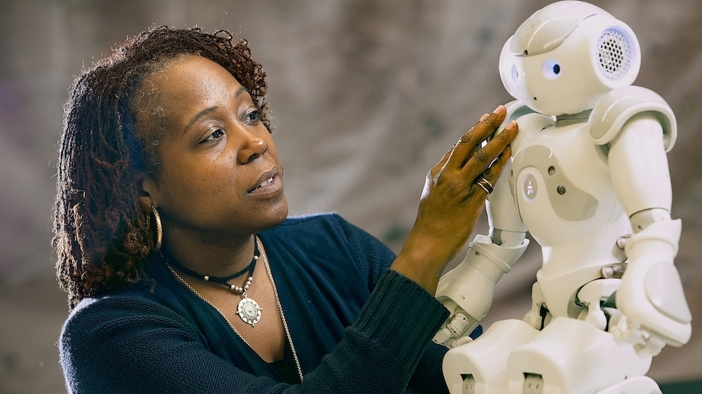
Dr. Ayanna Howard
Roboticist, NASA Engineer, Entrepreneur, Professor, & Dean
Learn more about her journey. Watch & Read, Deeper Read

Slide 19
Varieties of Autonomous Robots
Learn more about robots
Five warehouse robots: https://www.youtube.com/watch?v=9mG1bgs_ND0
This was video #4 in the preceding exercise.

Slide 20
My Dream Bot
Over the course of Unit 1, you will design your own dream robot.

Slide 21
Module 1.2 (B): Exit Ticket
Tip: Students should complete in their own Dream Bot slides
Let’s make your dream robot autonomous!
What decisions can your robot make?
…
…
…
…
…

